Slide 1
Troubleshooting Virtual Machines
Module 8

Slide 2
Importance
Administrators must understand how to quickly identify and effectively troubleshoot virtual machine problems to protect against application downtime, especially for mission-critical applications.

Slide 3
You Are Here
Course Introduction
Introduction to Troubleshooting
Troubleshooting Tools
Troubleshooting Virtual Networking
Troubleshooting Storage
Troubleshooting vSphere Clusters
Troubleshooting vCenter Server and ESXi
Troubleshooting Virtual Machines

Slide 4
Module Lessons
Lesson 1: Snapshot, Power-On, and Content Library
Lesson 2: Connection State and VMware Tools Installation

Slide 5
Lesson 1: Snapshot, Power-On, and Content Library

Slide 6
Learner Objectives
By the end of this lesson, you should be able to meet the following objectives:
Discuss virtual machine files and content IDs
Identify, analyze, and solve virtual machine snapshot problems
Troubleshoot virtual machine power-on problems

Slide 7
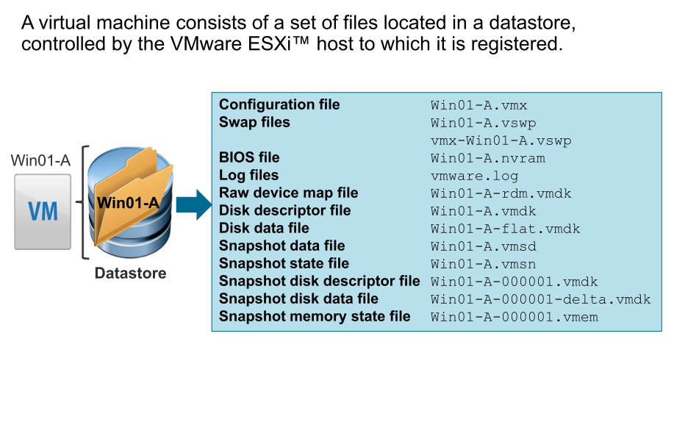
Review of Virtual Machine Files

Slide 8
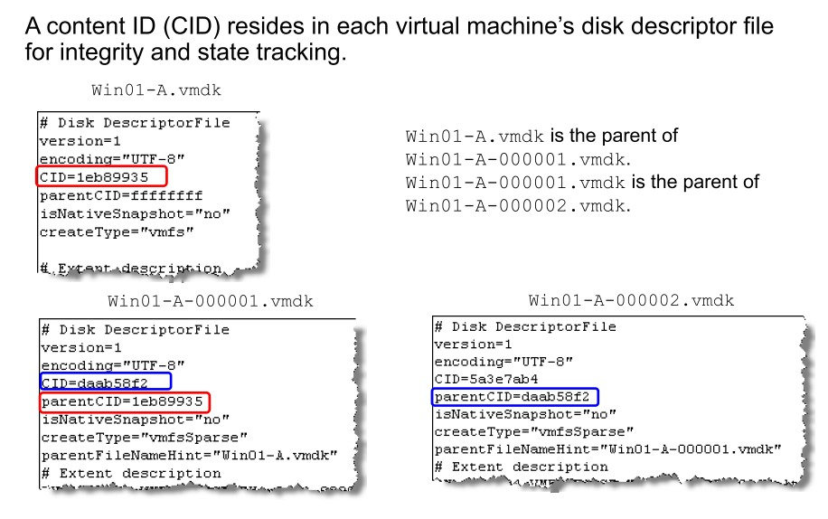
Disk Content IDs

Slide 9
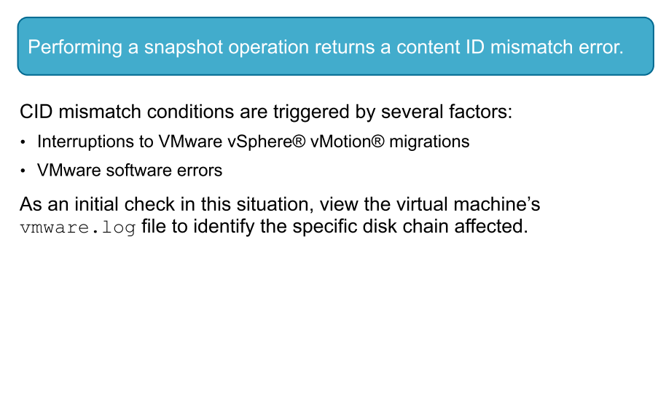
Virtual Machine Problem 1

Slide 10
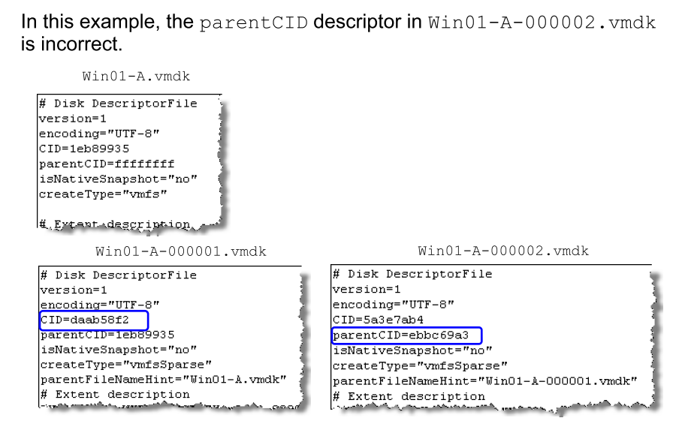
Content ID Mismatch Example

Slide 11
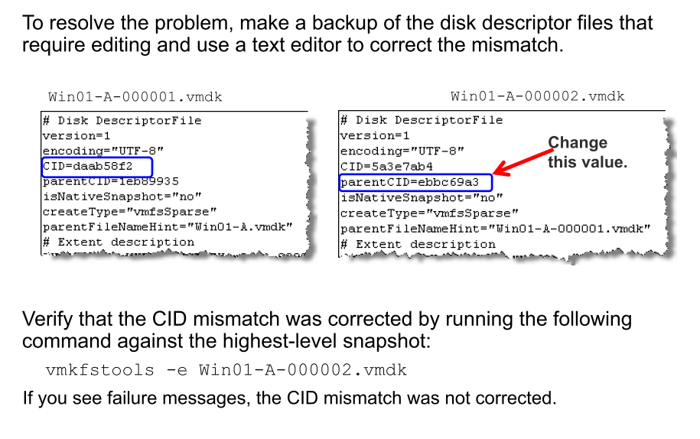
Resolving a Content ID Mismatch

Slide 12
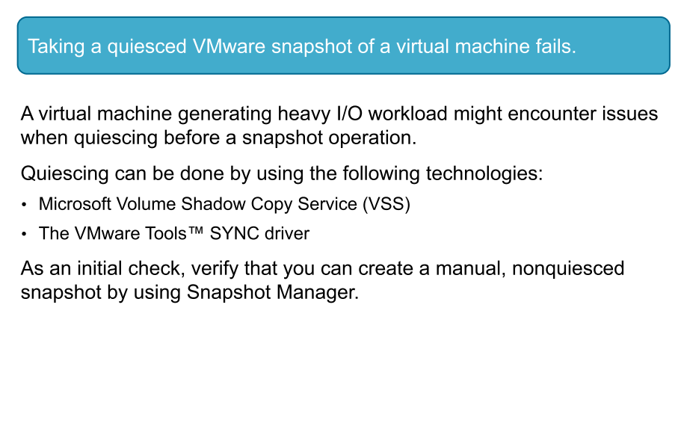
Virtual Machine Problem 2

Slide 13
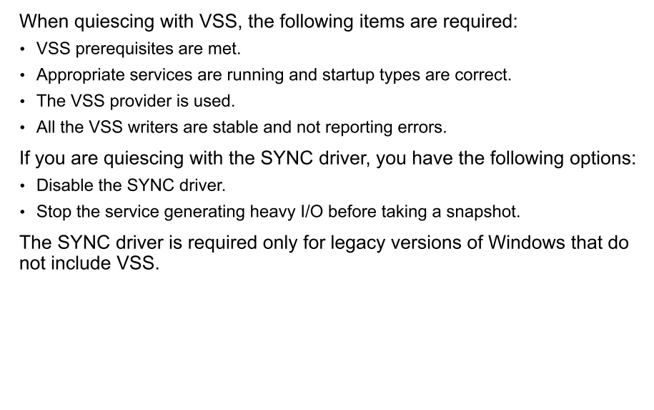
Resolving Quiesced Snapshot Failure

Slide 14
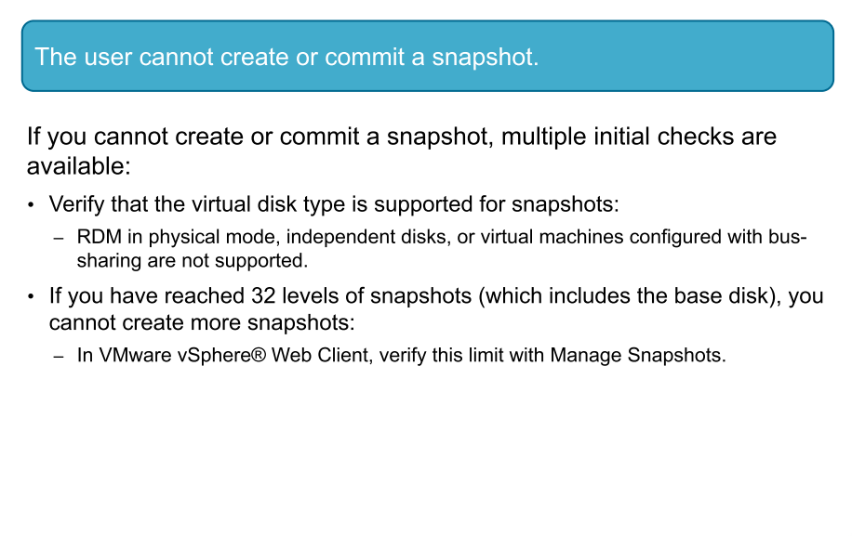
Virtual Machine Problem 3

Slide 15
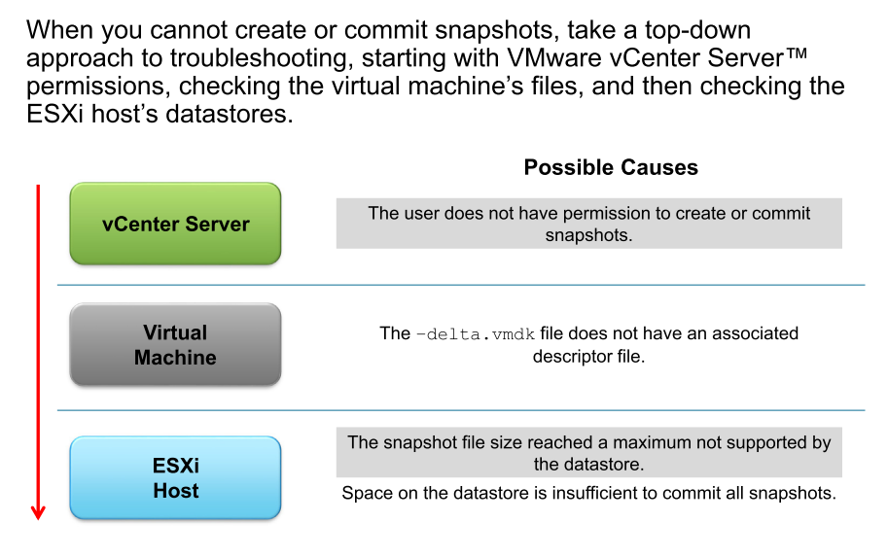
Identifying Possible Causes

Slide 16
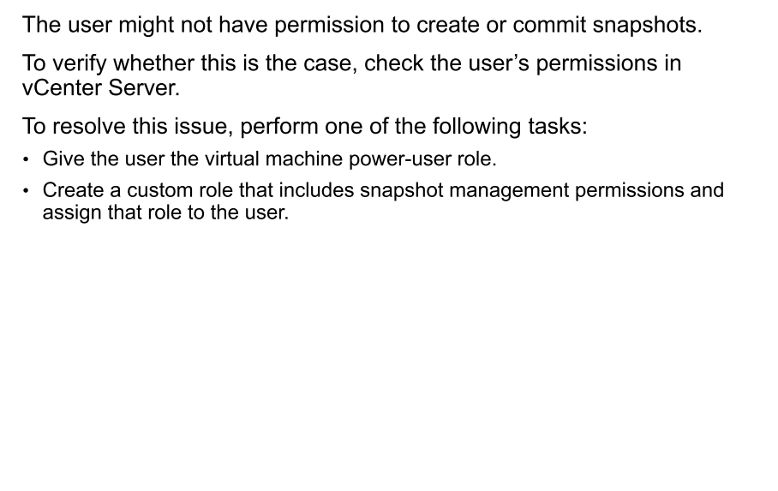
Possible Cause: No Permissions to Create Snapshots

Slide 17
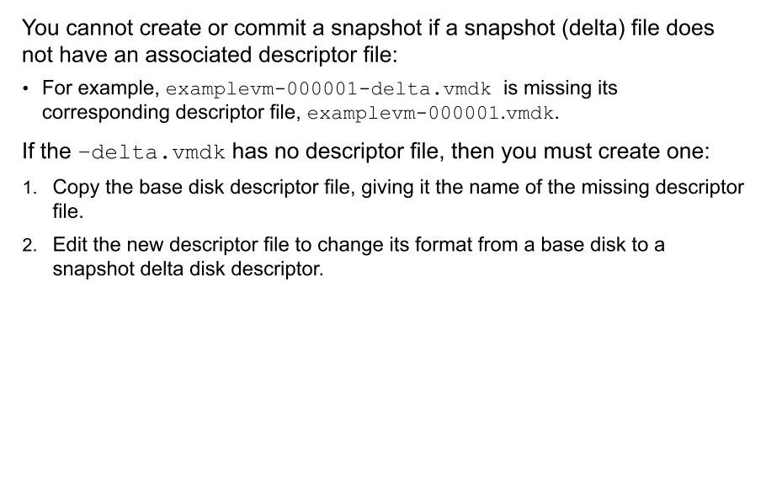
Possible Cause: Missing Delta Descriptor File
Notes:
http:// kb.vmware.com/kb/1026353

Slide 18
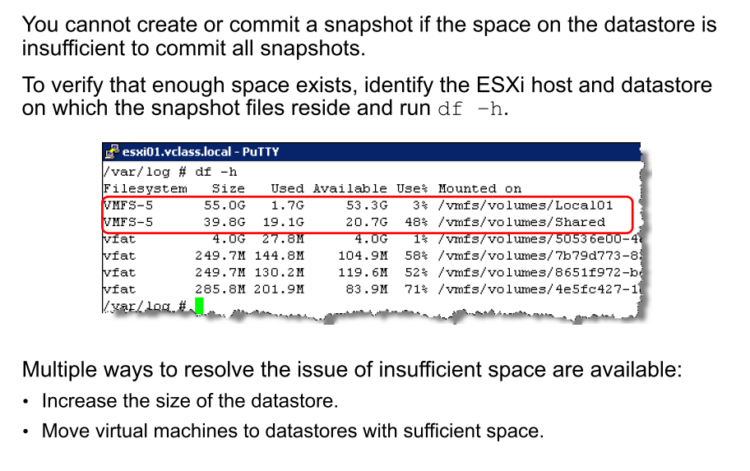
Possible Cause: Insufficient Space on Datastore

Slide 19
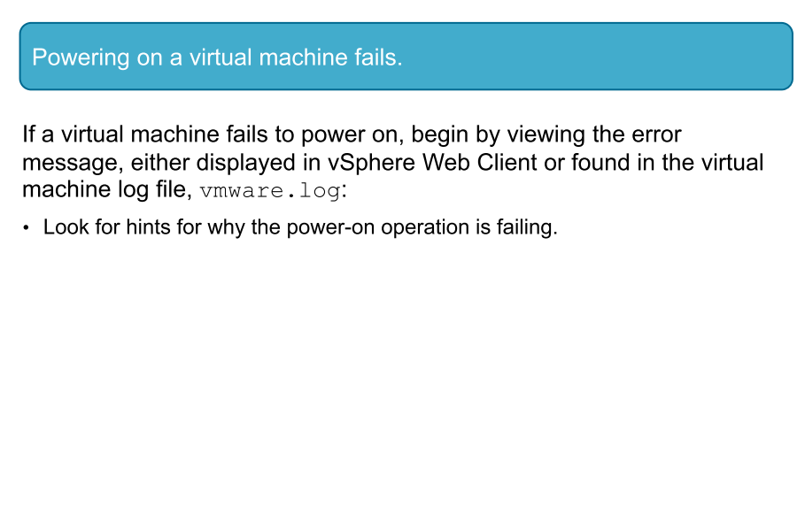
Virtual Machine Problem 4

Slide 20
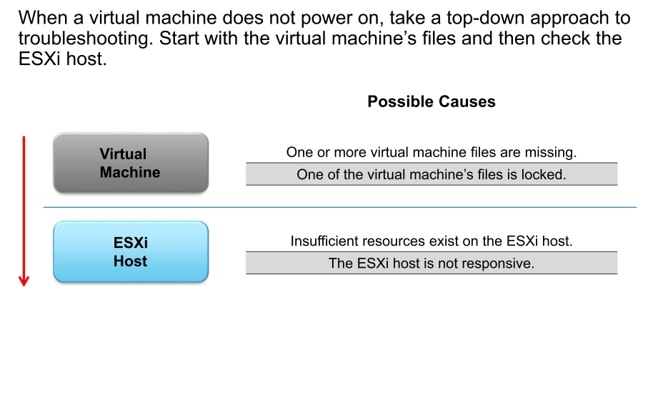
Identifying Possible Causes

Slide 21
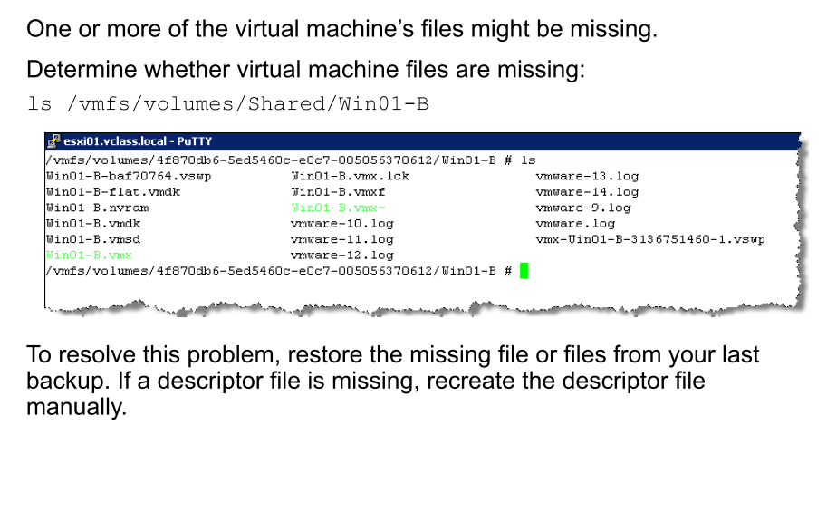
Possible Cause: Virtual Machine Files Missing

Slide 22
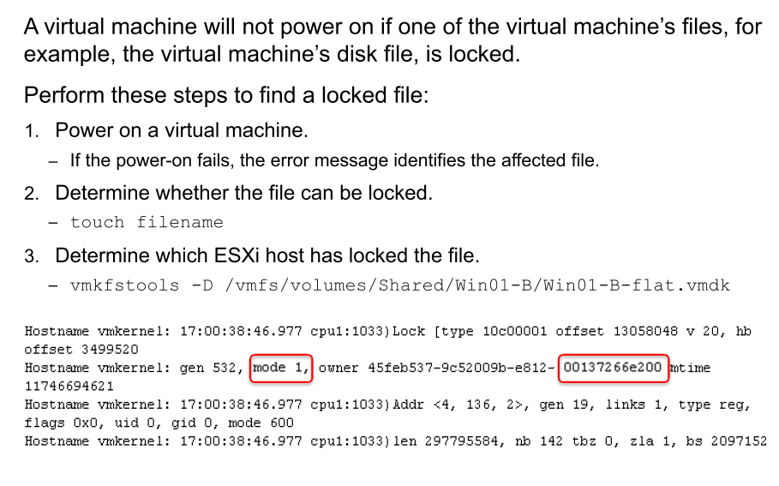
Possible Cause: Virtual Machine File Locked
Notes:
http://kb.vmware.com/kb/2107795

Slide 23
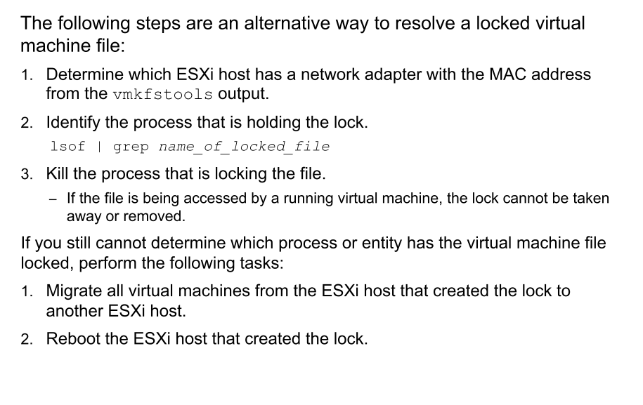
Resolving a Locked Virtual Machine File

Slide 24
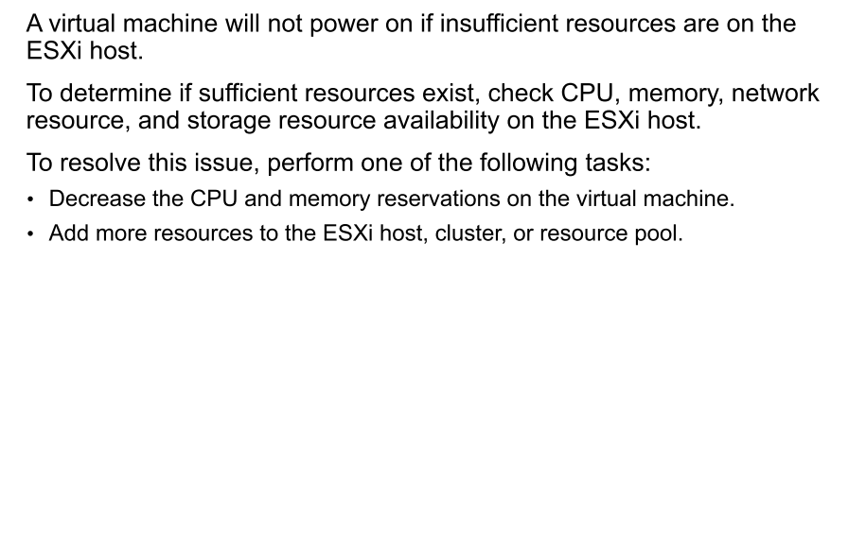
Possible Cause: Insufficient Resources on ESXi Host

Slide 25
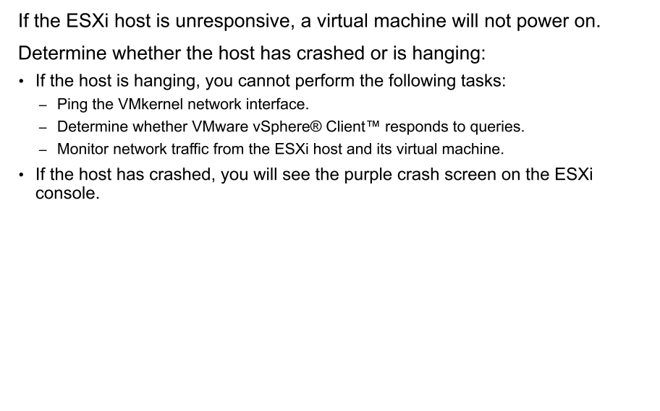
Possible Cause: ESXi Host Unresponsive

Slide 26
Review of Learner Objectives
You should be able to meet the following objectives:
Discuss virtual machine files and content IDs
Identify, analyze, and solve virtual machine snapshot problems
Troubleshoot virtual machine power-on problems

Slide 27
Lesson 2: Connection State and VMware Tools Installation

Slide 28
Learner Objectives
By the end of this lesson, you should be able to meet the following objectives:
Identify possible causes and troubleshoot virtual machine connection state problems
Diagnose and recover from VMware Tools installation failures

Slide 29
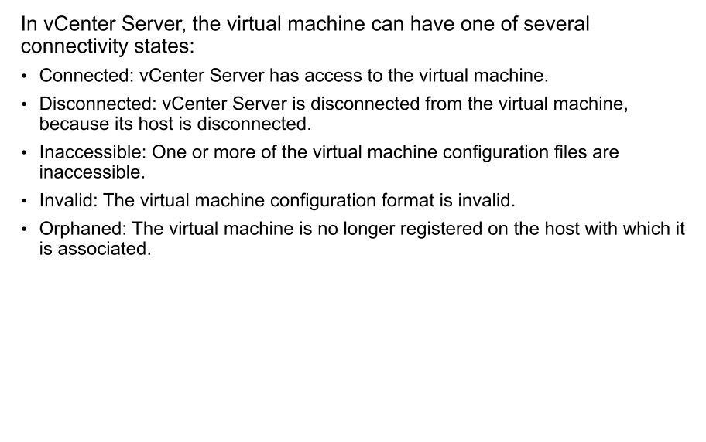
Review of Virtual Machine Connection States

Slide 30
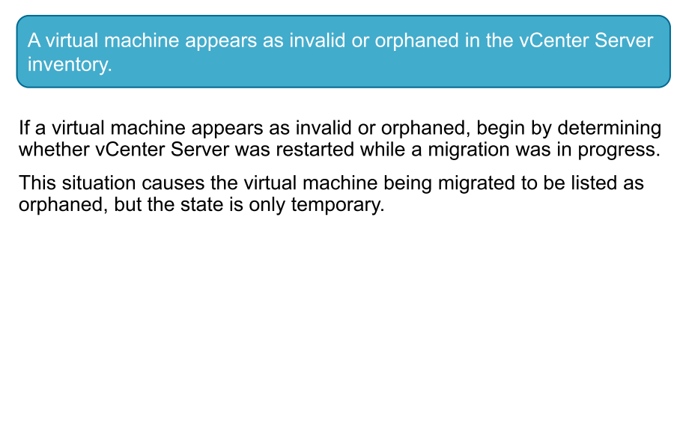
Virtual Machine Problem 5

Slide 31
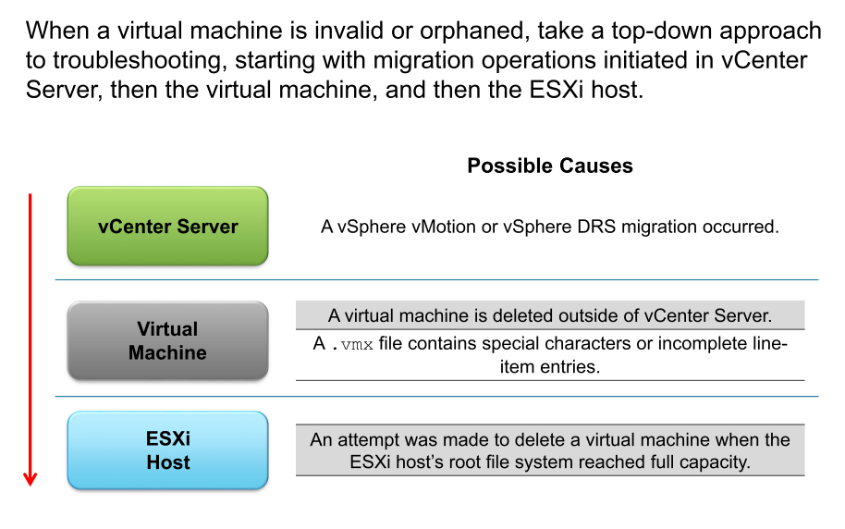
Identifying Possible Causes

Slide 32
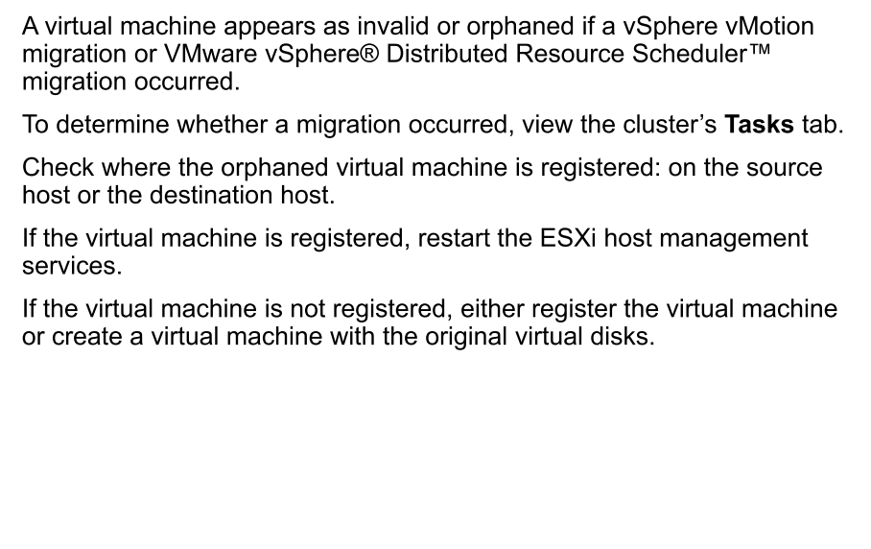
Possible Cause: vSphere vMotion or DRS Migration Occurred

Slide 33
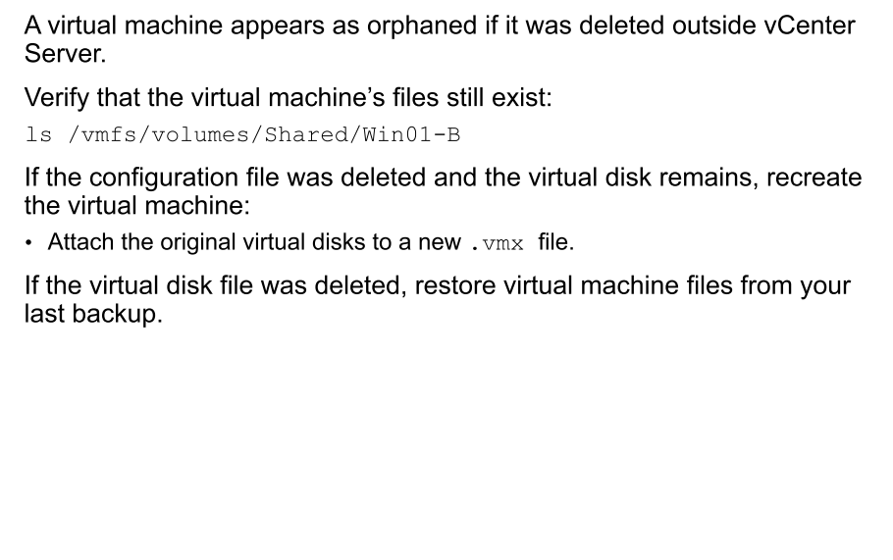
Possible Cause: VM Deleted Outside vCenter Server

Slide 34
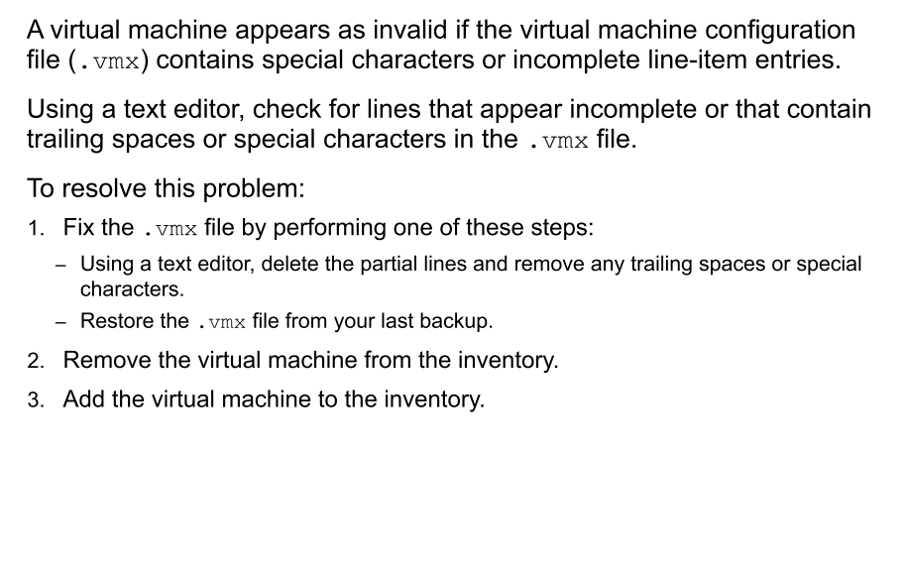
Possible Cause: Special Characters in the .vmx File

Slide 35
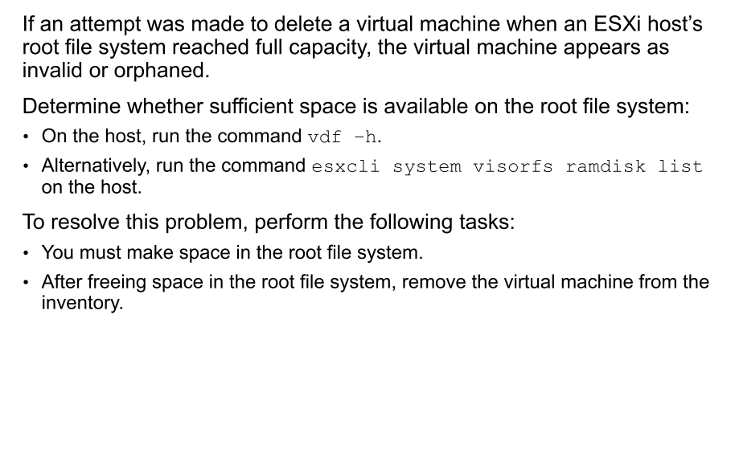
Possible Cause: ESXi Host Root File System Full

Slide 36
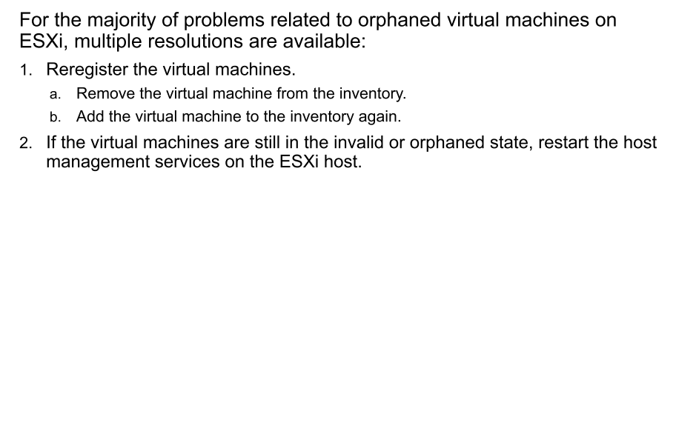
Recovering from an Invalid or Orphaned Virtual Machine

Slide 37
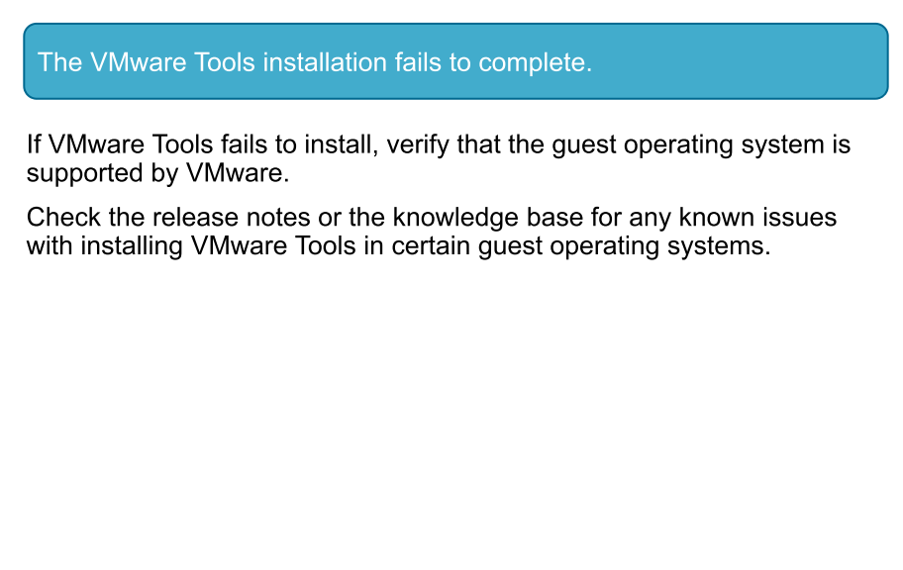
Virtual Machine Problem 6

Slide 38
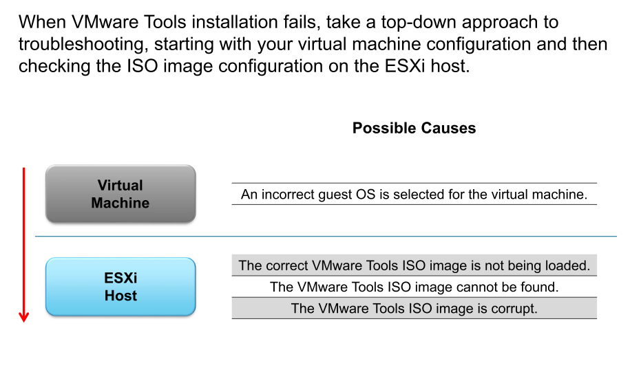
Identifying Possible Causes

Slide 39
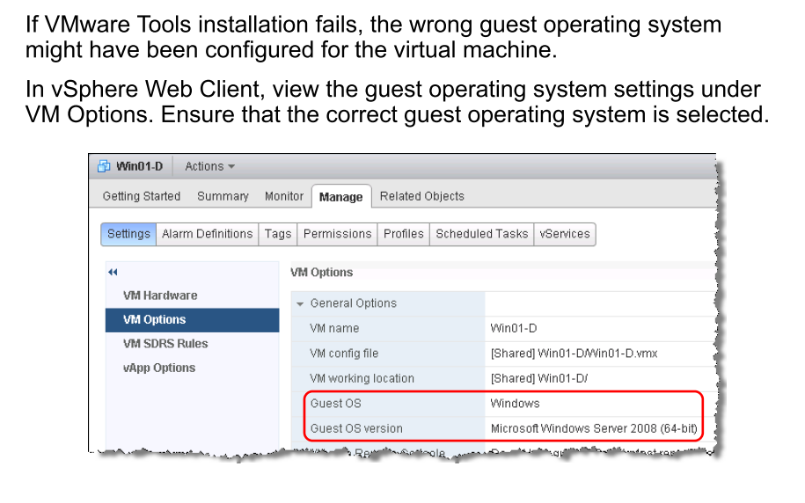
Possible Cause: Wrong Guest Operating System

Slide 40
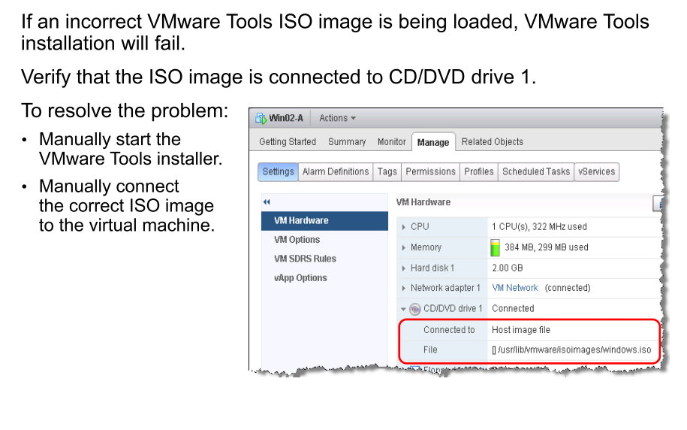
Possible Cause: ISO Image Not Being Loaded

Slide 41
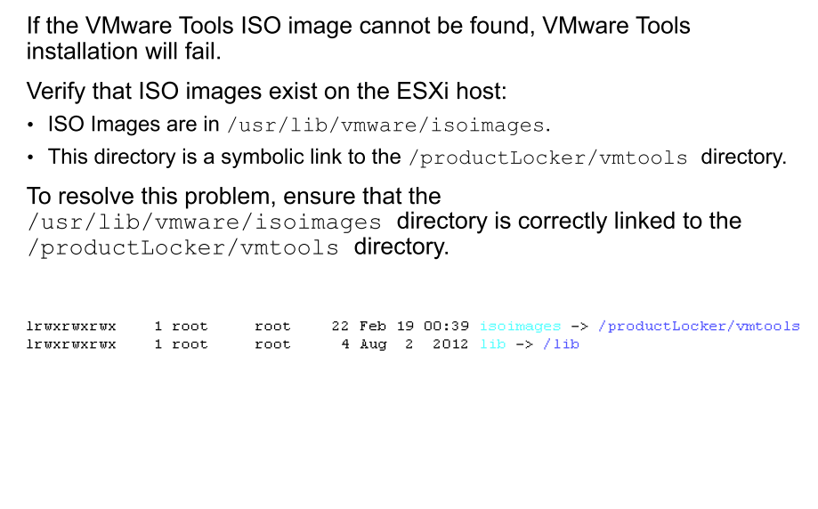
Possible Cause: ISO Image Cannot Be Found

Slide 42
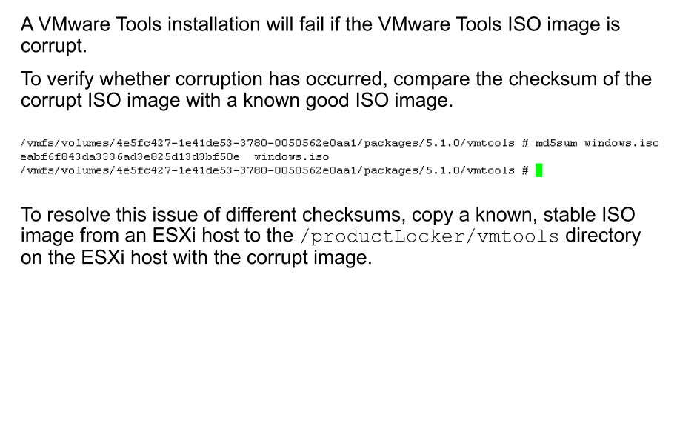
Possible Cause: VMware Tools ISO Image Corrupt

Slide 43
Review of Learner Objectives
You should be able to meet the following objectives:
Identify possible causes and troubleshoot virtual machine connection state problems
Diagnose and recover from VMware Tools installation failures

